Slide 1
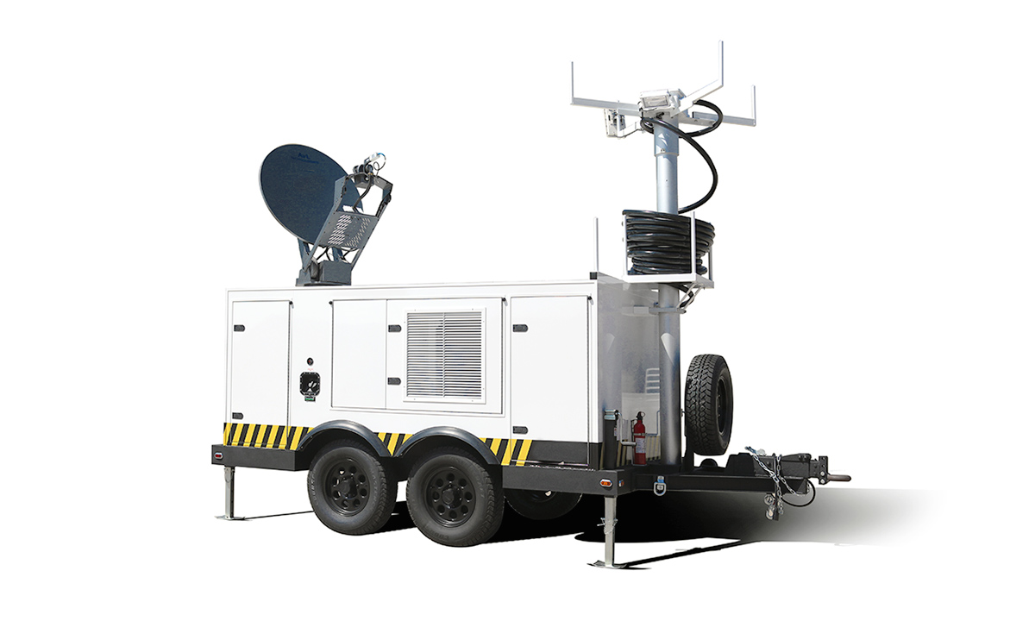


Mobile Cellular Communications
System
“Providing Wireless
Service Anywhere
In The World”
Proactive Energy Service’s
Mobile Cellular Base Station System
Proactive Energy Service’s mobile cellular system is the finest integrated system on the market, specifically designed for quick and reliable delivery of wireless communications to remote and rugged locations outside the footprint of traditional terrestrial services.
The trailered system provides every infrastructure
component required for stand-alone, off-grid delivery of multiple communication systems including Ku, Ka or C-Band VSAT, GSM / LTE cellular, 802.11g Wi-Fi, 2/5Ghz Point-to-Point and/or Point-to-Multipoint, and VHF or UHF radio in one rugged, air conditioned compact unit.
A commercial-grade diesel genset with automatic transfer
Switch will reliably back-up grid power or provide primary power for the system for up to 2 weeks without refueling.
A pneumatically operated 50’ telescopic mast provides
A stable platform for mounting multiple antennas, cameras, radios and scene lights.
3520 S. Sam Houston Pkwy. E.
Suite 400
Houston , Texas 77047
MAIN 713 955 5300
info@ProactiveEnergy.com

Slide 2
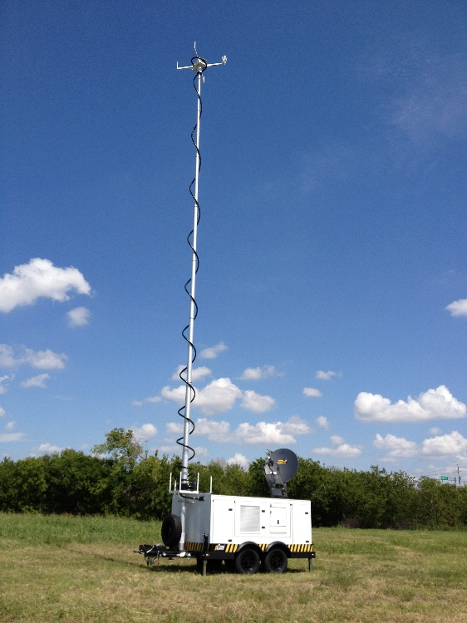
Mobile Cellular Communications
System Features
Trailer & Equipment Compartments:
Tandem axle, 7500# capacity
16” aluminum wheels
All steel frame construction, spray-lined
Electric trailer brakes
IP66 Weatherproof compartments
Lockable latches on every door
Vented genset compartment
LED lights with door switches in every
Compartment
Door catches secure while open
All Stainless hardware
Painted heavy aluminum compartment framing, ceiling and wall surfaces
Air-conditioned equipment compartments
Diesel Generator Power System:
Quiet 10Kw water-cooled diesel genset
93 Gallon fuel cell w/ electric pump
Digital generator voltage control
Automatic Transfer Switch
Integrated battery chargers
Auto-start feature
AC & DC Control Panels
LED lighting on control panels
Multiple GFI power outlets
12VDC power supply in equipment
rack and on mast junction enclosure
Master DC power switch
Mast-mounted high lumen LED scene
lighting system
Pneumatic Telescopic Mast:
50’ elevation at full extension
Dual air compressors
Compressed air tank
Electric rocker switch operation
Configurable mast head
Heavy duty Ny-Coil cabling system
with LMR-400 (3), DC power, and ethernet cables (4)
Heavy duty aluminum mast sections
Pressure relief valve
Stowed mast elevation at 10’
3520 S. Sam Houston Pkwy. E.
Suite 400
Houston , Texas 77047
MAIN 713 955 5300
info@ProactiveEnergy.com

Slide 3
Mobile Cellular Communications
System Features (continued)
Very Small Aperture Terminal (VSAT) System:
Auto-Acquire Single Button Operation
1.2M Ku / Ka Band or 1.8M C-Band
iDirect Evolution Satellite Router
Rugged, proven and reliable drive
motors and components
Minimal preventive maintenance
Configurable for anywhere in the world
Quick satellite acquisition with no
required pointing experience
Weatherproof components, IFL cabling
and connectors
AC powered BUC with LED transmit
indicator
2G / 3G GSM Cellular Base Station:
Private GSM network or GSM system
extension
Up to 100 concurrent GSM sessions
Rack-Mounted, compact base radios
Sectorized 120° Panel Antennas
provide true 360 degree coverage
Up to 50’ Elevation
Configurable for global or local connection
Remote monitoring, configuration & support
Weatherproof components, IFL cabling
and connectors
802.11g Wi-Fi and IP Video Systems:
2Ghz/5Ghz Wi-Fi via high power outdoor
MIMO access point
Up to 200 Meter access radius with 50’ mast
Multiple SSIDs and VLANs
6 Megapixel hemispherical video sensors
provide 360 degree fields of view
Digital pan/tilt/zoom operation – no moving
parts to fail
Web server / web interface / software view
On camera storage – up to 256Gb
Auto notification via e-mail, SMS, voice
Remote monitoring, configuration & support
Ultra low lumen night video operation
3520 S. Sam Houston Pkwy. E.
Suite 400
Houston , Texas 77047
MAIN 713 955 5300
info@ProactiveEnergy.com

